Slide 1

Revolutionizing System Management with AI
Ramadoss Mohan - AI-Insight

Slide 2

What is Ollama?
Key Features:
Model Management
Unified Interface
Extensibility
Performance Optimizations
Advantages:
Privacy and Security
Cost Efficiency
Customization
Reduced Latency

Slide 3
Ollama's Python Library
Ollama's Python library allows for:
Programmatic interaction with LLMs
Chatting, generating text, and customizing models
Integration with Python-based systems for AI-driven tasks

Slide 4

AI Agents
AI Agents :
Future we will have teams of AI agents working for us
Autonomous entities that perform tasks
Can interact with systems, analyze data, and make decisions
Leverage LLMs for intelligent behavior
Examples include monitoring, patch analysis, and security audits

Slide 5
Project Overview
An advanced AI-powered platform that:
Utilizes local LLMs through Ollama
Automates system management, security auditing, and monitoring
Supports RHEL, Ubuntu, Rocky Linux and windows
Future expansion to Kubernetes and EKS clusters

Slide 6

AI Agents in Action
Using Ollama's Python Library:
RHEL Server Monitoring System
RHEL Patch Analysis System
RHEL SSHD Security Audit Report
All code uses Llama 3.2 model and Mistral 8b

Slide 7

Live Demo
show the Demo with stock analysis with models
Live demo on the target servers on GCP

Slide 8
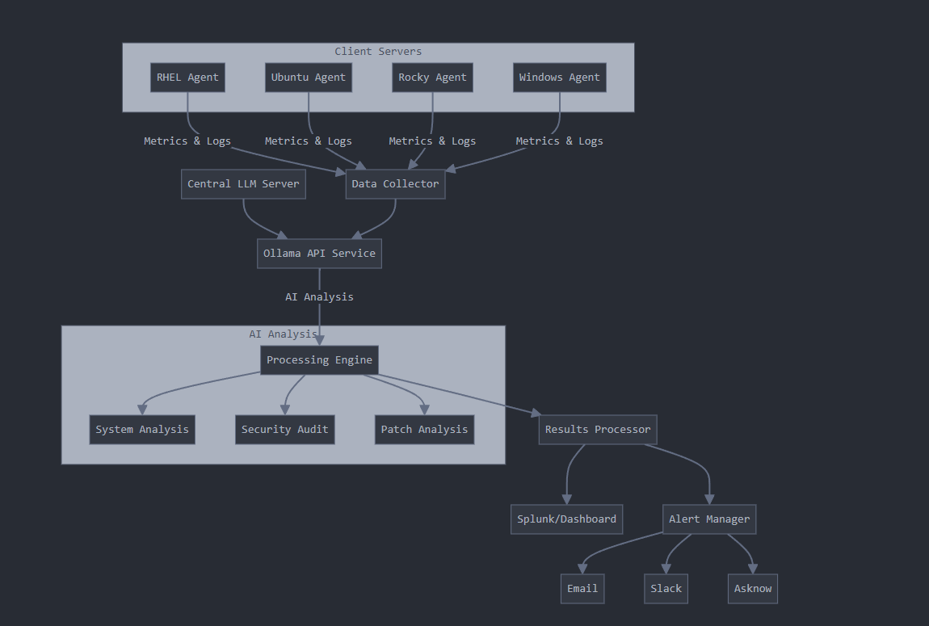
How It Works- High level
Ollama is installed in a central location:
Exposed on a port for access
Agents Can run and generate reports on the servers
Directly integrates with central Splunk for monitoring and analysis

